Slide 1
South Staffordshire Council Publication Plan (Regulation 19) April 2024
Plan inclusion of
Housing South of Wildwood on
Acton Hill

Slide 2
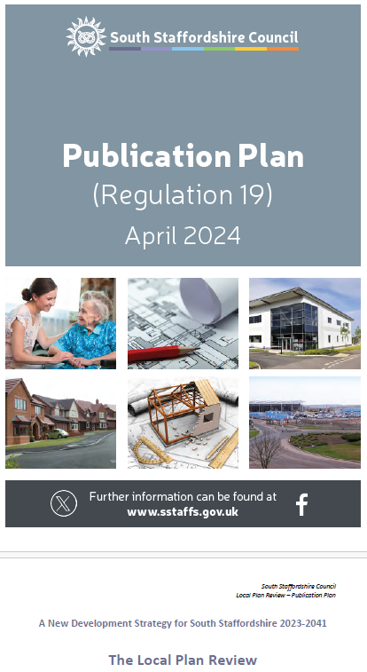
Housing South of Wildwood on Acton Hill
Final stage of ‘public consultation’ on the review of the Local Plan started 18 April 2024. SSDC advise:
This stage of consultation is different to earlier stages because it is about the legal soundness of the Plan. Has the council prepared the Plan positively? Is it justified and effective? Does it comply with national planning policy?
‘Consultation’ from Thursday, April 18 until 12 noon Friday, May 31, 2024
An Independent Planning Inspector will be appointed to conduct a formal Examination into the Plan

Slide 3
Housing South of Wildwood on Acton Hill
The Plan has been approved by a majority of South Staffs Councillors, not our local one. They ignored their own past refusal of the Acton Hill development in 2017
The Plan will NOT be changed before it goes to the Independent Planning Inspector
If we oppose this element (and any other elements) of the Plan our Representation MUST be suitable for the Inspector. This is our only chance!
Our Representation MUST highlight:
legal soundness of the plan
Is the plan prepared positively
Is it justified and effective
Does it comply with national planning policy
ESSENTIAL that we comment on Form LPR PB2 (not circulated by Council with their notice)

Slide 4
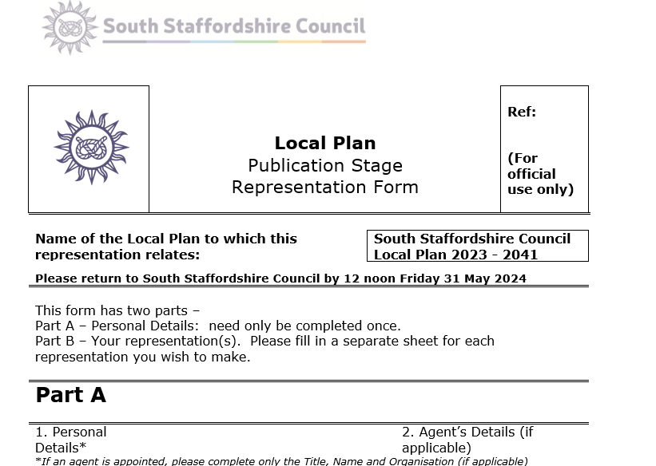
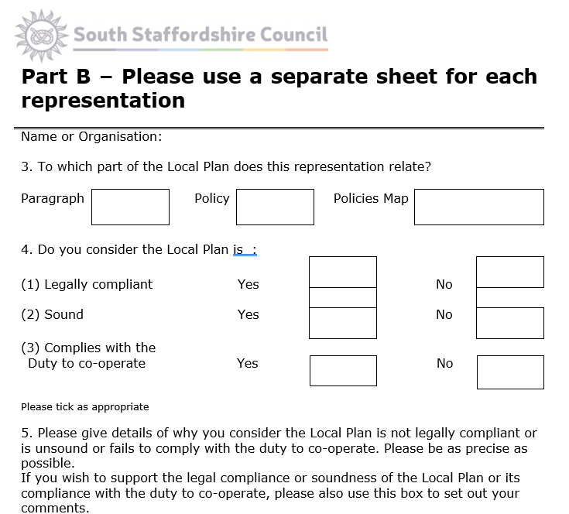
Housing South of Wildwood on Acton Hill
The FORM: 2 parts
Part A Part B
Some forms are here, BUT you need 1 for EACH Key Issue.

Slide 5
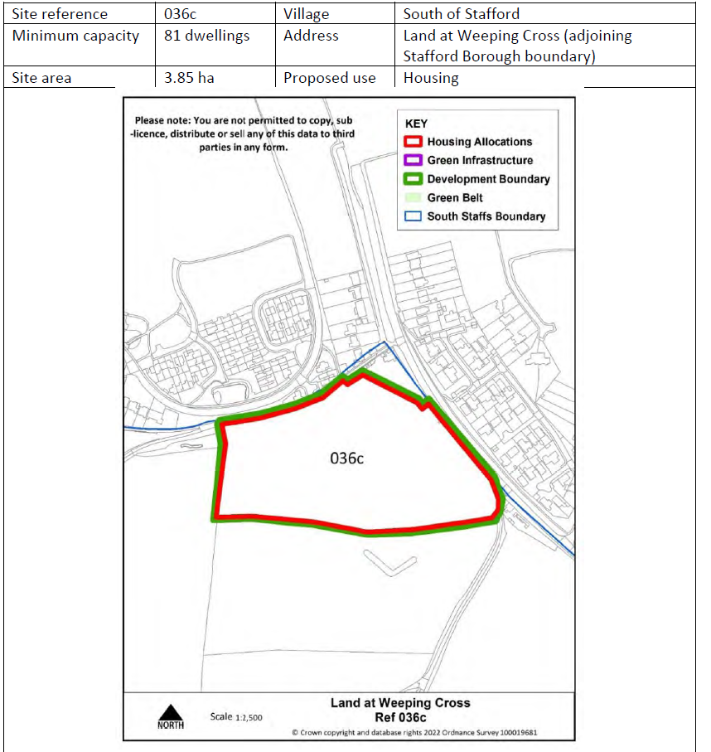
Housing South of Wildwood on Acton Hill
The Acton Hill Site for 81 Houses: Page 235 of Plan

Slide 6
Housing South of Wildwood on Acton Hill
The Acton Hill Site for 81 Houses: Page 235 of Plan
On boundary to Stafford; assumes all services from Stafford and SCC, but:
Local schools are full
Local heath provision is stretched
Traffic into town is awful
Stafford Borough Council oppose due to reasons above
It is uncertain that issues such as waste water (sewage) and surface water have been fully addressed
Many residents will travel though the Parish to work, and likely to schools and health centre
Development of this site with 81 houses may well assist much larger developments later

Slide 7
Housing South of Wildwood on Acton Hill
The Acton Hill Site for 81 Houses: Page 235 of Plan

Slide 8
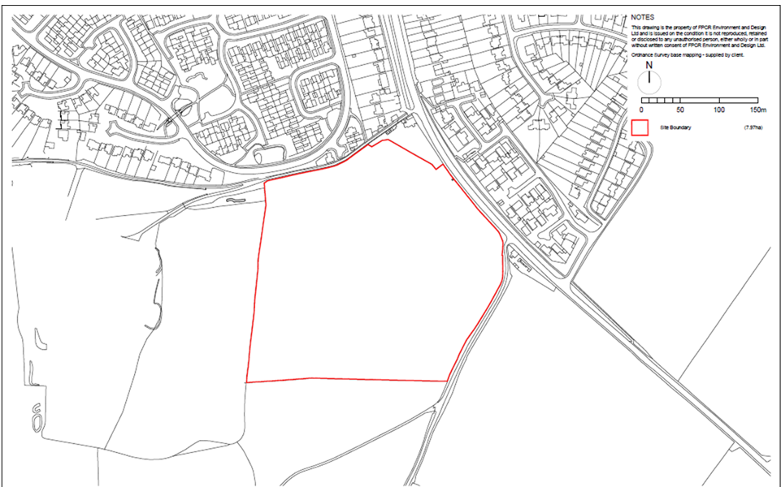
Housing South of Wildwood on Acton Hill
Previous Application proposal by same Developer 220 Houses, then reduced to 151, Rejected in 2017

Slide 9
Housing South of Wildwood on Acton Hill
The Developer has a track record of achieving one small development and then, because this reduces the basis for opposition, being granted the next ….. AND THE NEXT
From South Staffs Council URBAN EDGE SITES AND POTENTIAL NEW SETTLEMENTS
THE NEXT 2823 Houses filling ALL space between Stafford and the Parish of Acton Trussell, Bednall and Teddesley Hay: Classed ‘Potentially suitable’
Site 036c is present plan for 81 houses, site 036a is adjacent: 2823 houses…. Later? Not in present plan, only a ‘marker’ from Gladman Development (now owned by Barratt Developments Plc)

Slide 10
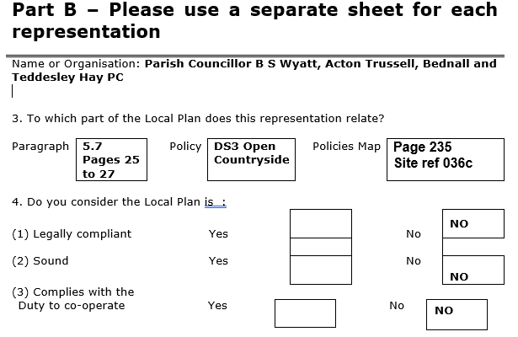
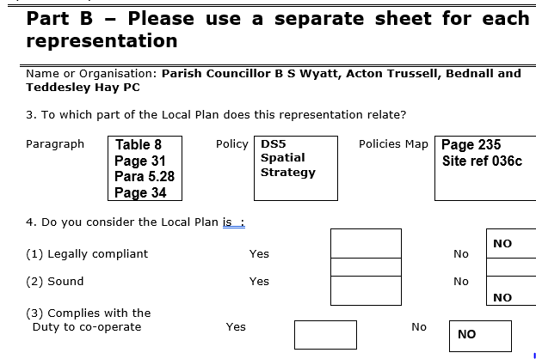
Housing South of Wildwood on Acton Hill
My DRAFT Representations not yet complete or secure:
I expect to submit at least 4, including HC 15 Education and other Key issues: NOT Justified (excess provision, wrong location, not compliant with NPPF thus not legal, not a positive planning progress, did not advise use of above Form, ignored clearly known public opinion and their own past Councilor’s decisions. YES, complex. YES, worth doing

Slide 11
Housing South of Wildwood on Acton Hill
QUESTIONS

Slide 12
Housing South of Wildwood on Acton Hill
WHAT NEXT
Download the Plan (or I can e-mail it to you: Provide e-mail on forms at back)
Read the BLUE Policy documents
Consider how the Plan for Site 03c breaches these and comment accordingly
Comment on Form LPR PB2 (I can e-mail it to you: Provide e-mail to me)
Use 1 Form B for each Policy
Submit BEFORE 12 noon Friday, May 31, 2024
Can submit by e-mail: address on back of form: localplans@sstaffs.gov.uk
Keep copies and proof of sending
PARISH COUNCIL: Can we:
Identify and appoint Expert Planning Consultant to submit PC Objections (alongside OURS) and provide Expert Opinion to Inspector??

